Slide 2
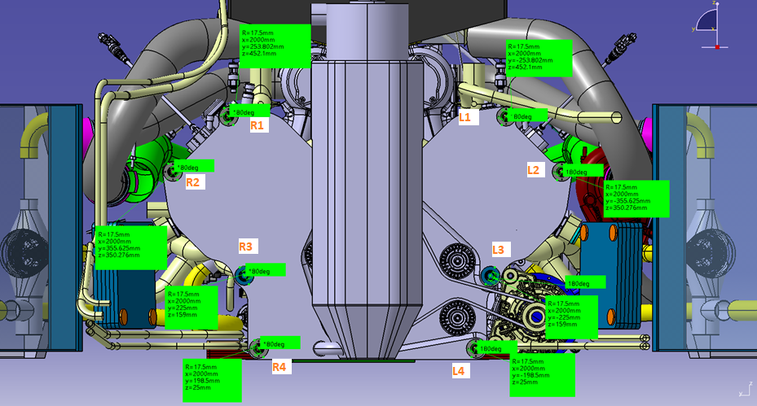
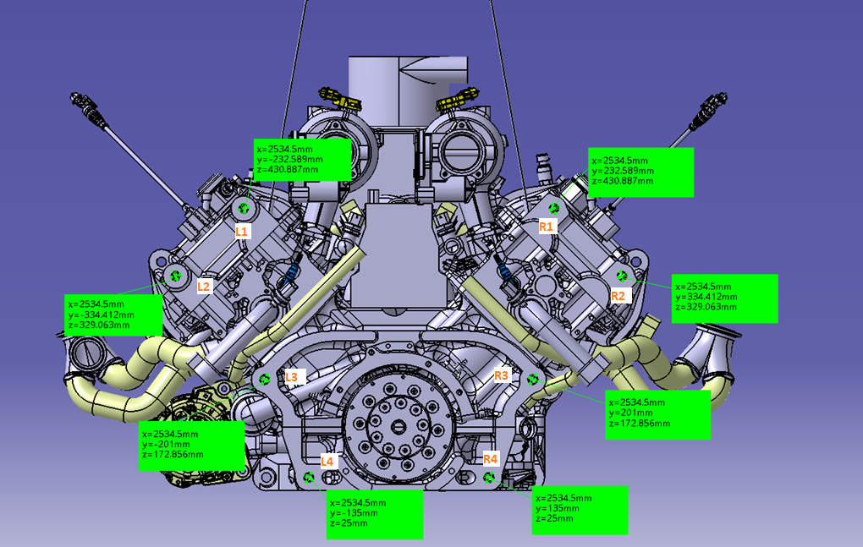
Studs overview
Monocoque to engine studs
Engine to bellhousing studs

Slide 3
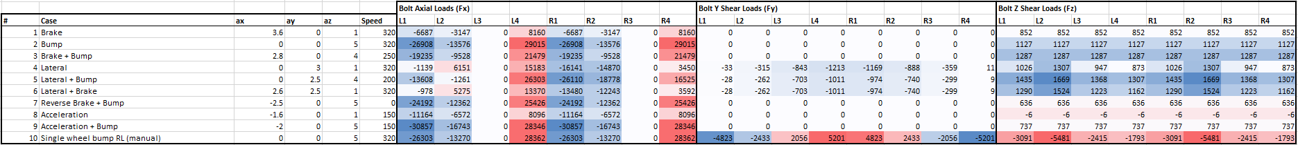
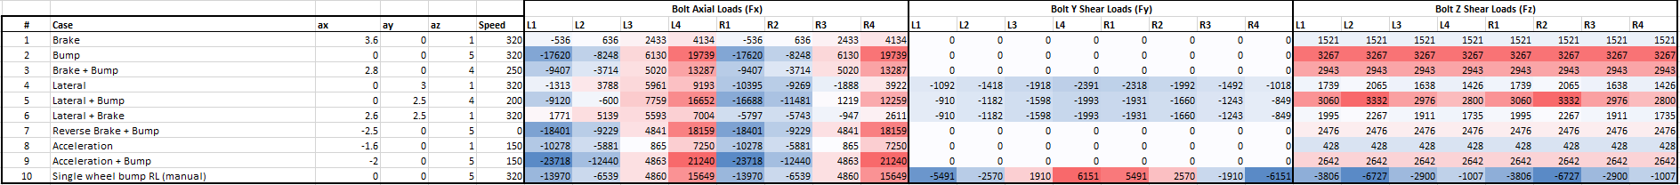
Load cases
Monocoque to engine studs
Engine to bellhousing studs

Slide 4
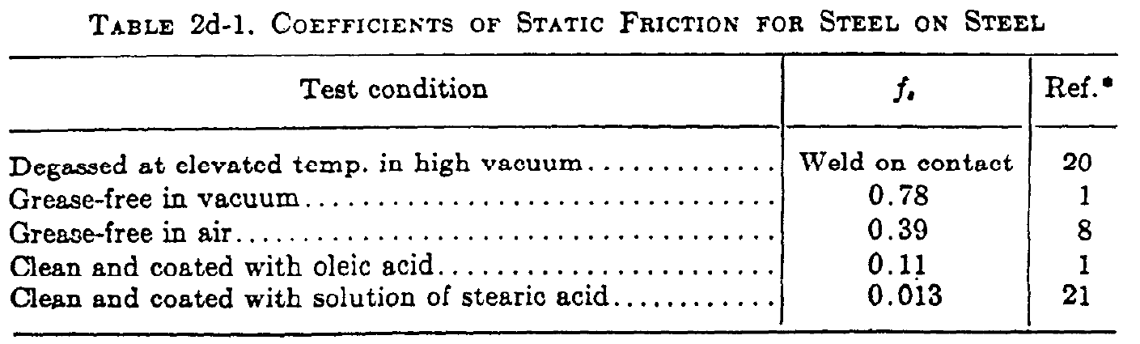
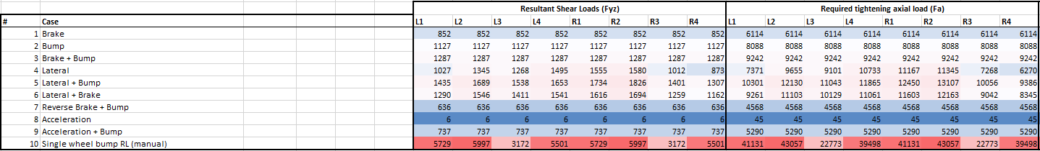
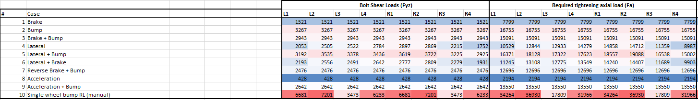

Required axial load computation
2.8 monocoque
Required axial load calculation
$$F_{V}=\frac{F_{yz}∗SF}{f}$$
2 bellhousing
Monocoque to engine studs
Max: 43000 N
Engine to bellhousing studs
Max: 37000 N

Slide 5
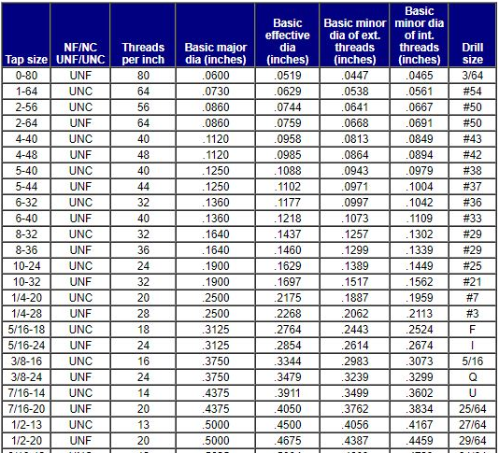
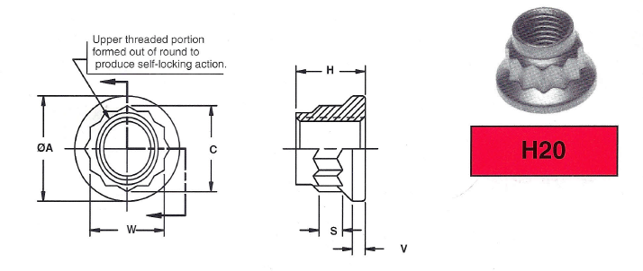
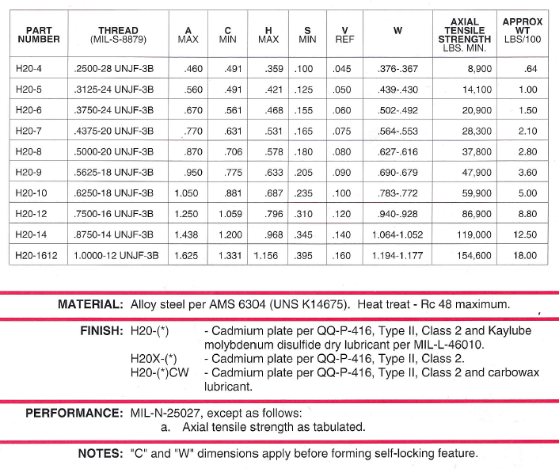
Thread data

Slide 6
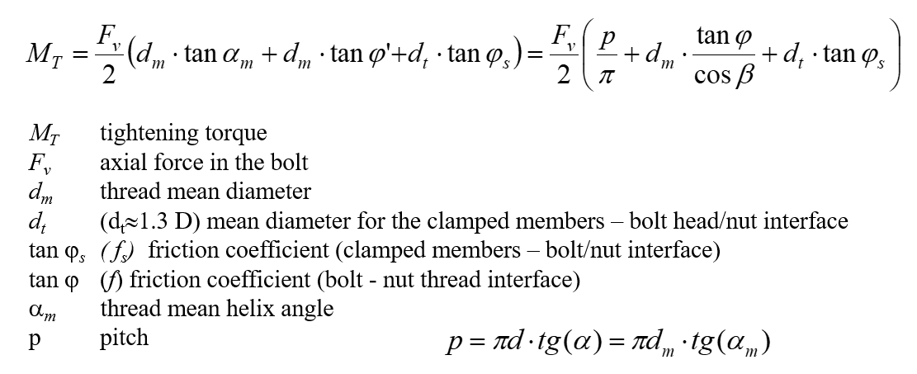
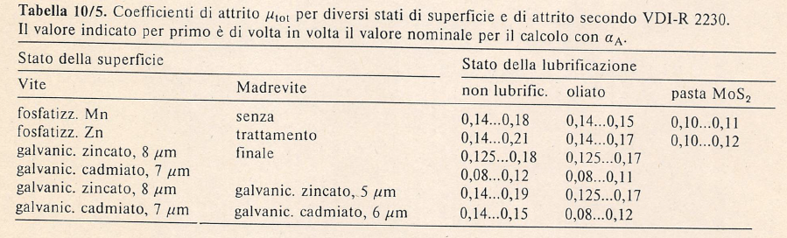
Tightening torque calculation
Monocoque to engine studs: 89 Nm
Engine to bellhousing studs: 78 Nm

Slide 7
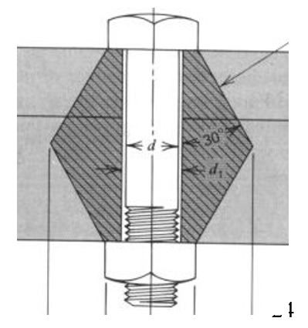
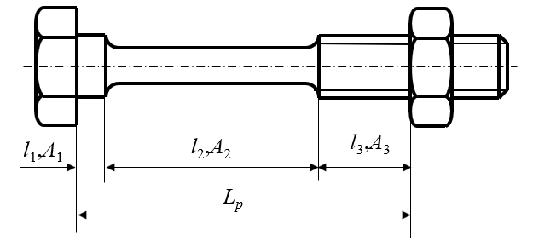
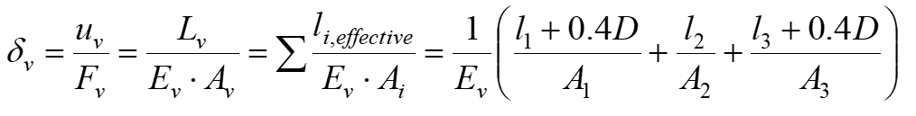
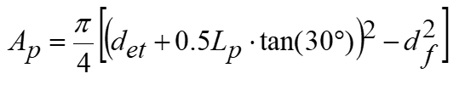
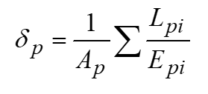
Members compliances
Clamped elements
Stud

Slide 8
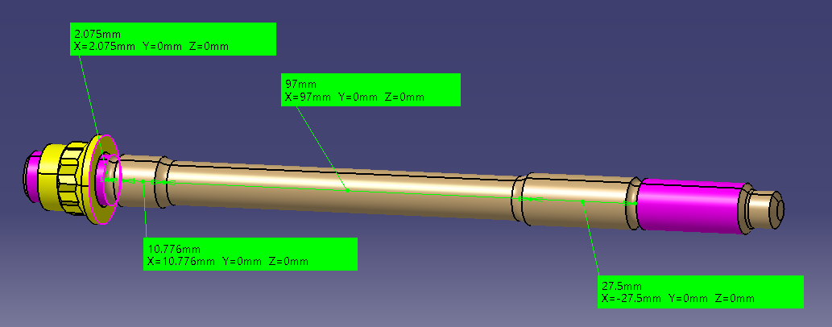
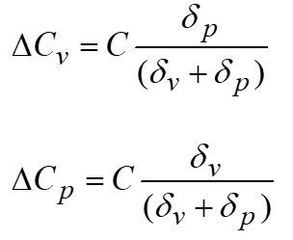
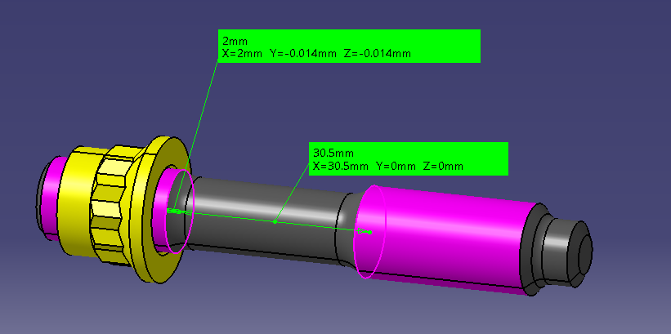
External load repartition
Monocoque to engine studs
Peak tensile load: 29015 N
Load on clamped elements: 26309 N
Load on stud: 2706 N
Engine to bellhousing studs
Peak tensile load: 21240 N
Load on clamped elements: 15641 N
Load on stud: 5599 N

Slide 9
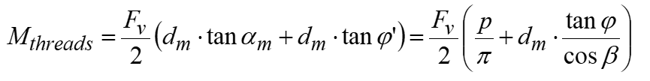
Stud safety factors
Operation SF
Loads: axial preload + peak external tensile load + torque from thread friction
Minimum section
Monocoque to engine studs
Operation SF: 2.1
Tightening SF: 1.6
Tightening SF
Loads: axial preload + tightening torque
Root section
Engine to bellhousing studs
Operation SF: 2.3
Tightening SF: 1.9

Slide 10


Loosening verification
Clamped members preload reduction due to external loads
Monocoque to engine studs
Flim = 15377 N
Fv min = 16571
Torque wrench precision
$$F_{vmin}=F_{v}∗a−{∆C}_{p}>F_{lim}$$
Engine to bellhousing studs
Flim = 18465 N
Fv min = 21127
Minimum acceptable axial preload
$$F_{V}=\frac{F_{yz}}{f}$$

Slide 11
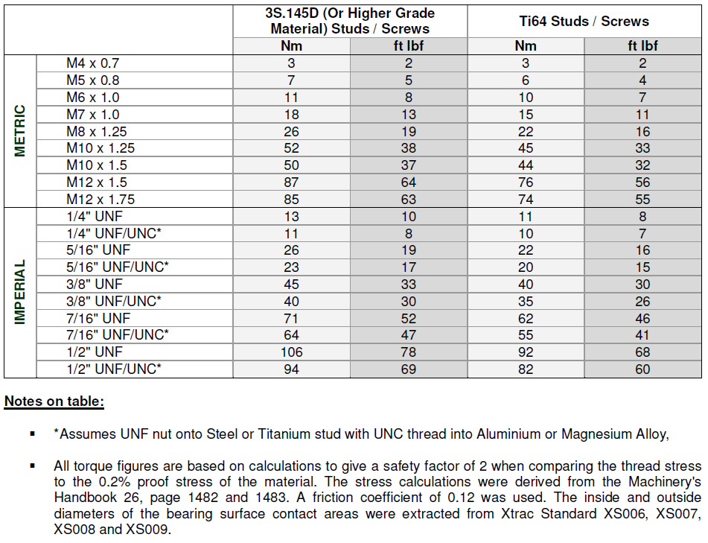
Xtrac reference

Slide 12
Conclusions
Monocoque to engine studs
90 Nm tightening torque
Lubricated threads during installation
If above 90 Nm, the operation SF goes below 2
Engine to bellhousing studs
80 Nm tightening torque
Lubricated threads during installation
90 Nm possible
If above 90 Nm, the operation SF goes below 2

